Slide 1

Risk-Aware UAV Path Planning Under Communication Uncertainty

Slide 2

Mission Objective
A UAV must:
Travel from start to destination
Maintain reliable communication
Minimize energy and path length
Key Challenge
Communication quality is uncertain.
This makes the optimization problem stochastic.
01/07/19
| 2

Slide 3
What Is the Decision Variable?
The decision variable is:
P=UAV trajectory
The UAV chooses:
Its 3D position over time.
We want to choose the best trajectory P.

Slide 4
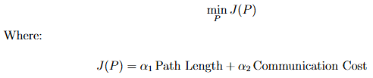
Deterministic Formulation
If everything were known perfectly:
Assumption:
Communication quality is fixed and predictable.
This is unrealistic.

Slide 5
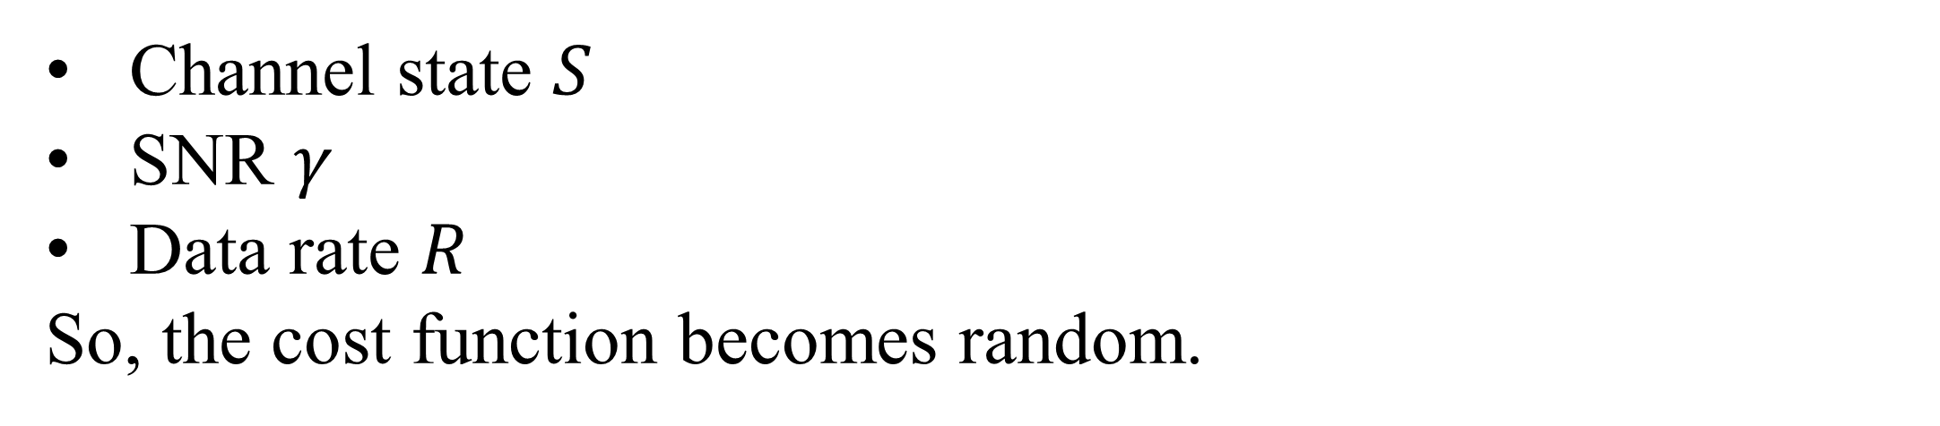
Where Does Randomness Enter?
Communication depends on
Distance between UAV and user
Line-of-Sight (LoS) or Non-LoS
Channel fading
Environmental effects
Random variables involved
Channel state $S$
SNR $γ$
Data rate $R$
So, the cost function becomes random.

Slide 6
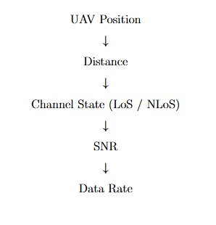
Dependency Structure
There is a chain of dependence:
This shows that:
The trajectory affects communication reliability indirectly.
01/07/19
| 3

Slide 7
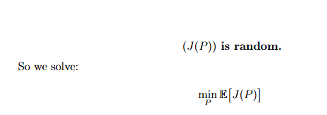
Stochastic Optimization Formulation
Since communication is random:
Now we are minimizing the expected cost.
This is a stochastic optimization problem.

Slide 8
Why Expectation Is Not Enough
Two possible paths:
Path A:
High average rate
Large fluctuations
Path B:
Slightly lower average rate
Very stable
If we minimize only expectation, we may choose an unstable path.
This introduces risk.

Slide 9
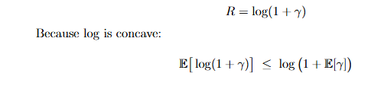
Jensen’s Inequality Insight
Data rate:
Meaning:
Variability in SNR reduces effective rate.
So, uncertainty directly harms performance.

Slide 10
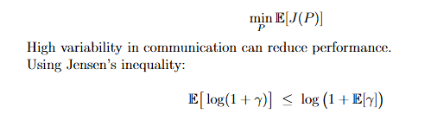
Risk-Aware Formulation
Instead of only minimizing expectation:
This shows:
Variability in SNR reduces achievable data rate.
Uncertainty directly impacts system performance.
So, understanding randomness is essential.

Slide 11
Algorithm Used
Spherical Vector-based Particle Swarm Optimization (SPSO)
Important points:
Particles represent candidate trajectories
Random numbers guide exploration
Convergence is probabilistic
Even the algorithm itself is stochastic.

Slide 12
Critical Evaluation
Assumptions in the paper:
Static obstacles
Known channel model
No wind disturbance
Perfect position knowledge
Real-world systems include:
Sensor noise
Dynamic obstacles
Environmental uncertainty
So, risk modeling becomes important.

Slide 13
Summary of Group-Level Understanding
Key Takeaways
Path planning is a decision under uncertainty.
Communication variability affects performance.
Expectation alone is insufficient.
Risk-aware optimization improves reliability.
Jensen’s inequality shows impact of variability.

Slide 14
Conclusion
We transformed the problem from:
Deterministic optimization
to
Stochastic, risk-aware optimization.
This provides deeper understanding of:
Randomness
Decision-making
Risk modeling
Optimization under uncertainty

